Slide 1
Sales Force Strategy &
Decision Support:
Promotion Mix and Targeting
PMA Methodology Overview
September 15, 2005

Slide 2
Physician-Level Data Sources
IMS Data
IMS Physician profile (name, address/ZIP, specialty)
TRx/NRx by month, by HCP, by product (by payer type is also available)
These data are used to generate therapeutic class and product deciles
Dendrite Data
Transaction-level sales force activity by HCP, product, date, and call type (details with or without a sample, lunches, speaker programs, audioconferences); sample quantity by HCP, date, and sample description
Bridge File (links Lilly Reference Number with Affilid/Affilsrc)
Vendor Data
Activity (Brand-driven programs, direct mail, Rx Pads, Starter Kits) by HCP, date, and program
Lilly Lecture Bureau (Cialis Lecture Bureau) Data
Internal data on speakers and associated fees
Segmentation Data

Slide 3
Definitions
Details includes sales force details with and without sample, and lunches with and without detail message (lunches and strictly defined details were broken out in brand-specific analyses)
Samples includes all samples for the product. The optimization assumed that a sample would incur an opportunity cost from lost TRx. This higher cost was used as an intermediate step in the optimization, but only the actual sample COG was used for the recommendation
Audioconferences includes either a taped or remote live peer-to-peer discussion, whether or not the rep delivered samples to the customer
Speaker Programs includes all live speaker programs, whether or not the rep delivered samples to the customer
Other DTP includes Branded Rx pads (Mediscripts), branded tchotchkes, satellite programs, starter kits, etc. Although these interventions have been summarized into one line item here, they were analyzed separately
Direct Mail includes all targeted mailers

Slide 4
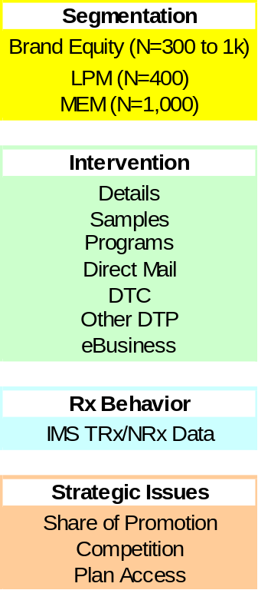
Promotion Mix Process
What is the right level of interventions and their mix?
Promotion Mix Optimization
Within Brand & Across Brand Tradeoffs
What is the
optimal call plan?
Targeting & Local Market Optimization
Implementation & Measurement

Slide 5
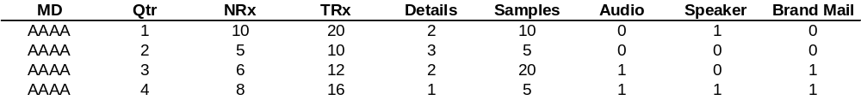
Promotional Mix Architecture (Mix Model) Conceptual illustration
Time series data on MDs
12 months of data for about 100,000 MDs
Response Models
Conceptually like regression but incorporates
  Correlations of MD behavior over time
  Takes into account MD prescription volatility
  Incorporates hierarchy in terms of MD segments
Widely used in Consumer packaged goods, Travel and Pharma industries
Optimization
Non-linear programming techniques used to make trade-offs across channels
x
x
x
x
x
x
x
x
x
Inc NRx
x
x
x
x
Inc $
x
x
Convert Inc NRx to Inc $ using refill, price
Convert activity to cost using cost per activity
x
Details
Details Cost ($)

Slide 6
Response Modeling Methodology
Response model estimates
  Incremental NRx due to MD level interventions
  Carryover of NRx that would occur without promotional effort
Mixed Models methodology is employed to estimate the response model
  Allows handling of correlation in MD behavior over time
  Allows variation in responsiveness of interventions by segment
    Segment definition is specific to the brand
    Segments could be based on brand team strategy, MD share behavior and attitude
  Possibility of estimating individual level responsiveness estimates while using information across the population (Bayesian shrinkage)
Optimization
  Nonlinear Programming is our primary tool -a classic technique for optimization
  Artificial Intelligence methods are used to handle more complex problems, such as cross-brand tradeoffs
  The idea is to recommend the optimal solution, not simply the first acceptable one

Slide 7
Promotion Mix Optimization
Goal: Optimally allocate resources across different physician groups and marketing channels to maximize profit while meeting operational and business constraints
Level of interventions
Decision variables
Response Models
  Incremental NRx
Price per TRx
Forecast
Refill
Margin
Inc Revenue
(3 yr)
Inc Cost
Maximize
Inc Revenue – Inc Cost
Non-linear optimization algorithm is used to optimize the level and mix of interventions
Objective

Slide 8
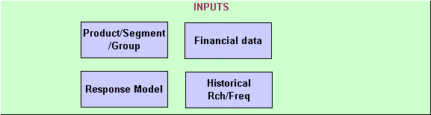
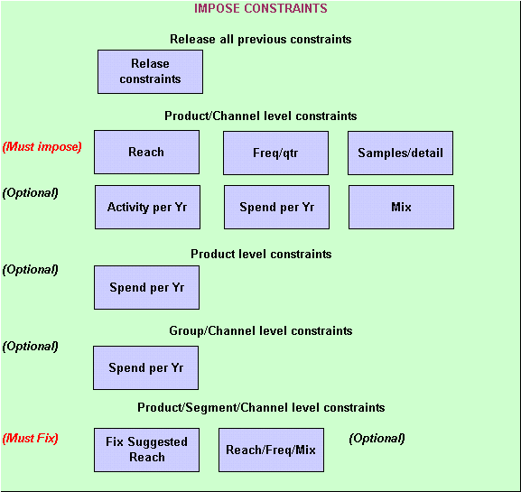
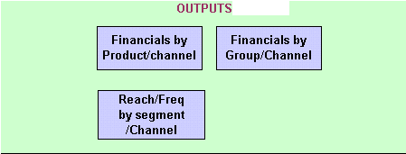
Promotion Mix Optimization

Slide 9
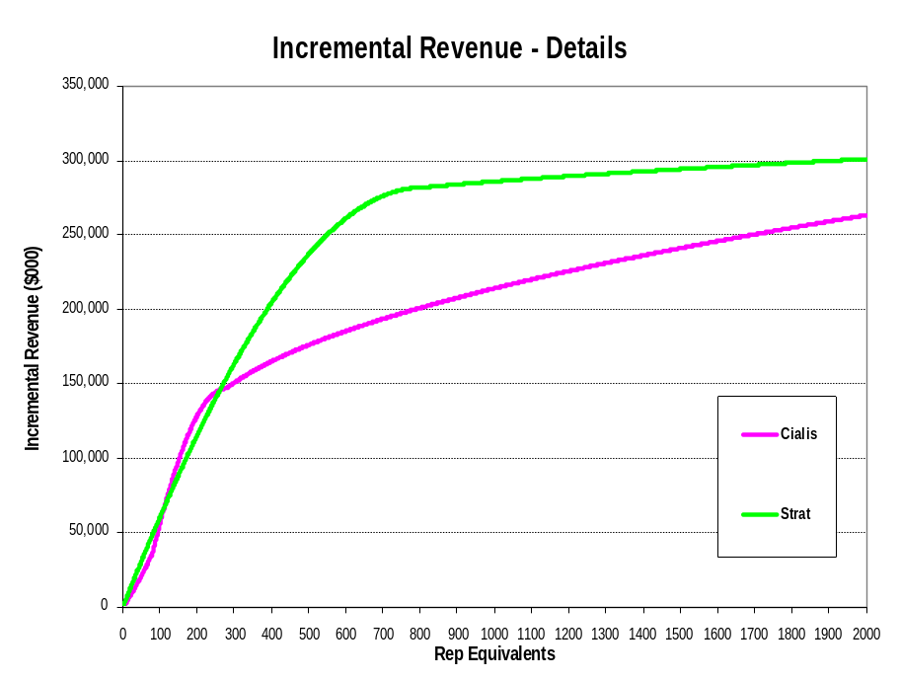
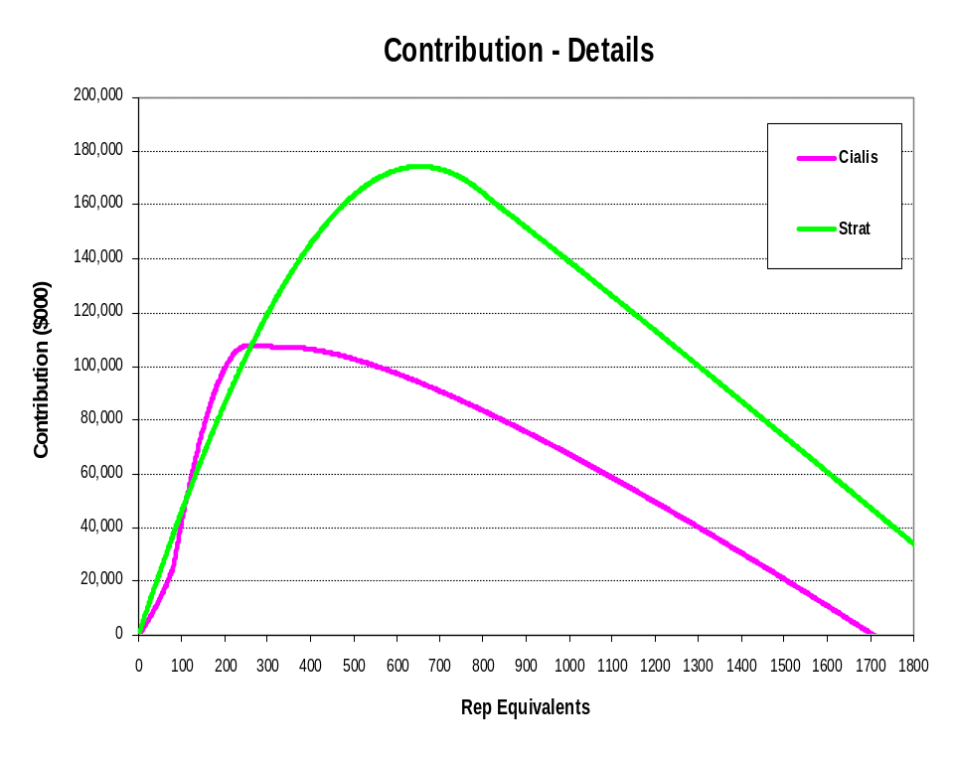
Response Model Output (Sales Force)
Contribution: One year of direct sales + two years of discounted carryover sales – one year of cost
Incremental Revenue: One year of direct sales + two years of discounted carryover sales

Slide 10
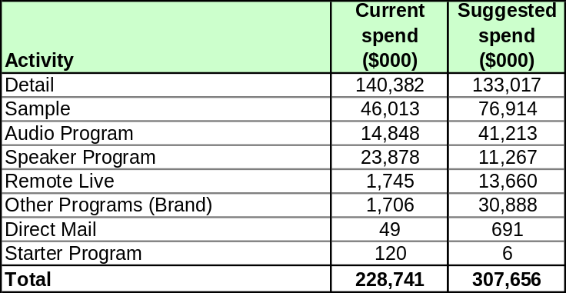
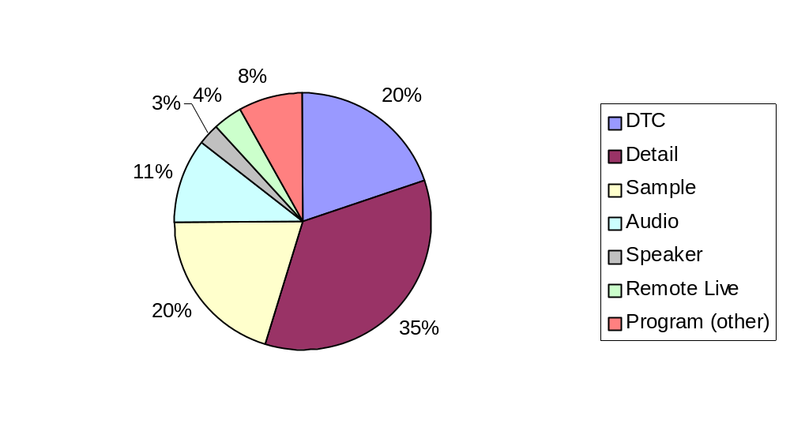
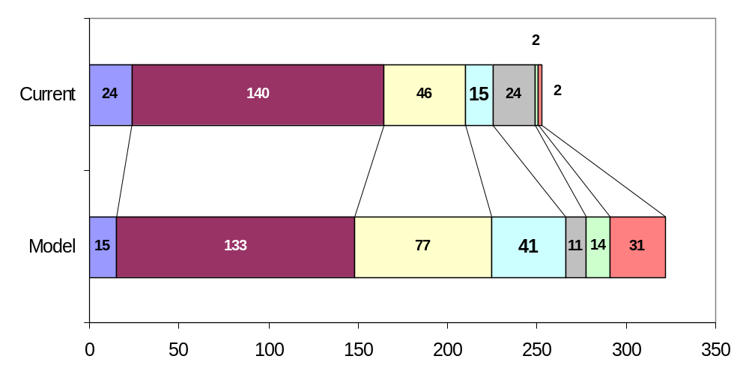

Strattera mix analysis
We suggests an increase in total spend of 28% over current levels
The mix of promotional activity suggests:
  Reduction in percentage spent on detailing
  Increasing percentage on sampling
  Reducing percentage on speaker programs
1
Note:
Promotional spend based on detailing, sampling, programs, mail and starter pack to the 106,086 MDs used for analysis and the cost assumptions per activity
DTC mix is assumed constant at 20%
Direct Mail and Summer Program not shown since the % mix is less than 1%

Slide 11
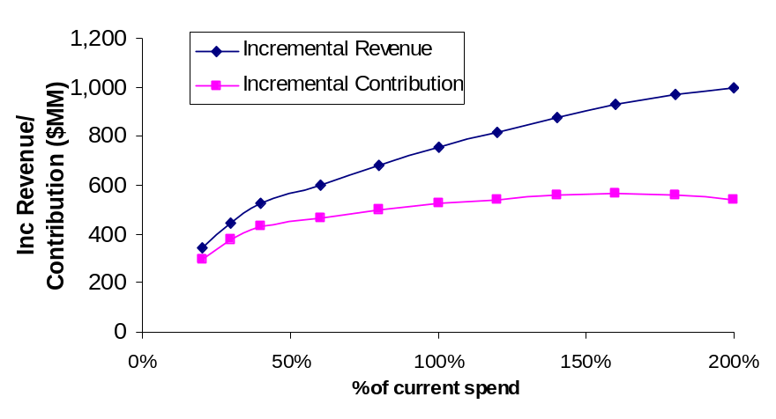
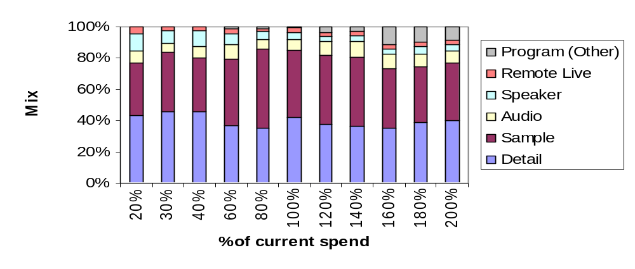
Strattera Mix: Sensitivity to Spend
Optimal Mix for Strattera changes as the total level of spend changes

